Slide 1

Year 3
Information for Parents
and Carers

Slide 2
Staff working in Year 3
Teacher
Mr Cowie
PPA Cover (Thursday PM)
Mrs King (History/Geography)
Mr Troth (PE)
Miss Pinfold– Teaching Assistant
Miss Smitheringale – Teaching Assistant

Slide 3

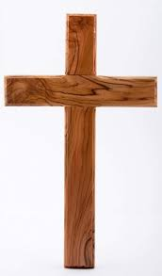

Worship
Worship will take place every day at 8:50am in the school hall. This will be led by different staff members, as well as representatives from St. Guthlac’s Church.
Merit worships take place on Friday mornings to celebrate individual children’s work and birthday celebrations are held on Thursdays.

Slide 4
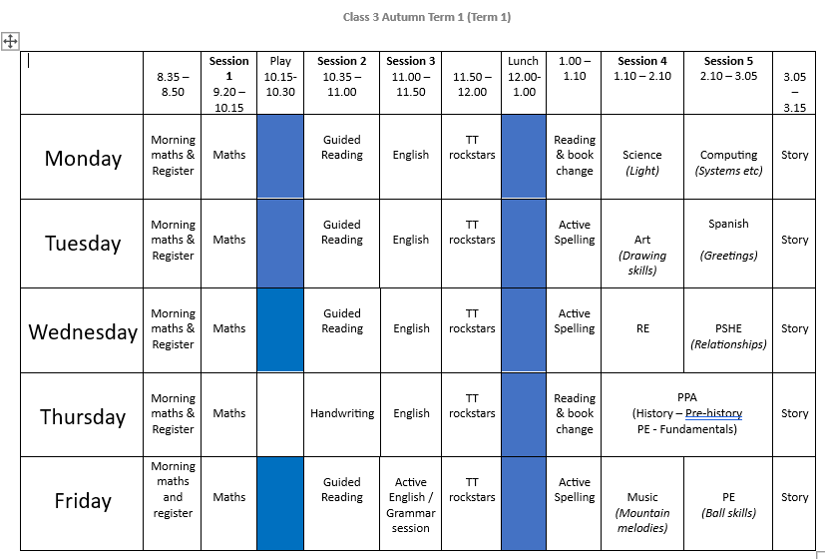
Year 3 Timetable:

Slide 5
What are the learning themes / topics in
Year 3?
Term 1 - Would you rather live in the Stone,
Bronze or Iron age?
Term 2 – Why do people live near volcanoes?
Term 3 – Why did the Romans invade & settle in?
Britain?
Term 4 – Are all settlements the same?
Term 5 – What was important to the Ancient
Egyptians?
Term 6 – Why are rainforests important?

Slide 6
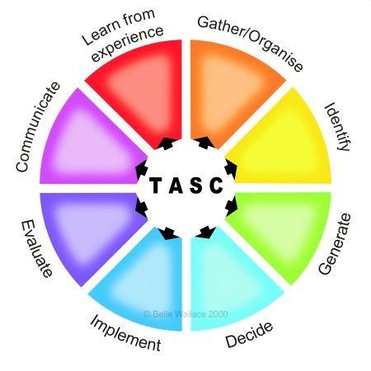
The children will be working on the Year 3 standards in the National Curriculum.
How do we judge how well your children are progressing?
Sharing learning objectives and success criteria together.
Questioning
Partners/Small group work
Self evaluation
Using and Applying
Guided groups
Recorded work
Summative assessment
Thinking actively in a social context
Notes:
thinking actively in a social context

Slide 7
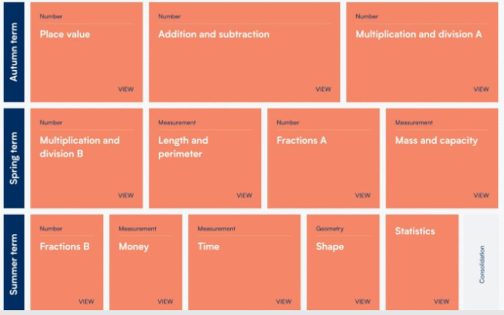
Maths:
These are the areas that the children will work on during Year 3.

Slide 8

Maths
For information on how we are teaching maths in school, please follow the link below.
School website –> Our Learning -> Maths support

Slide 9
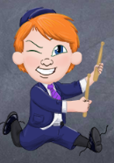
Multiplication
TT Rockstars:
Please use the Times Tables Rockstars app or
via the website at home to support your child with
learning their tables.
Times tables will form part of the weekly homework in Year 3.

Slide 10
Maths:
Properties of Number- Large numbers, place value, decimals
Addition and Subtraction- mental strategies and formal written methods
Problem solving, reasoning and algebra
Multiplication and Division – mental strategies and formal written methods
Ongoing practice of mental maths and arithmetic in
timed conditions
School website –> Our Learning -> Maths support

Slide 11
English: Term 1
Active English – focus on spelling, grammar and punctuation
Focus text: ‘Stone Age Boy’
Text types and skills to be covered:
-Narrative – creating own text based on one read in class.
-Note taking etc.
-Setting descriptions
-Instructional writing.
-Character descriptions

Slide 12
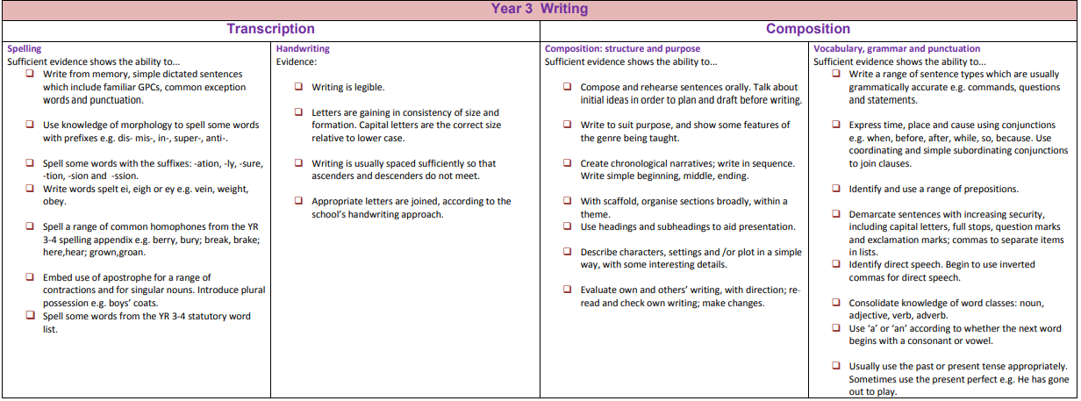
Writing expectations for Year 3.

Slide 13
Spelling in Year 3
In Year 3, your child will continue to develop their spelling. They will write and read more, learning more complex spellings as they go. They will use dictionaries to check words they are unsure of.
We use ‘Active Spelling’ daily and there will be a new spelling pattern each week. These are practiced daily in school and set for homework.
You can work on the Y3/4 spelling key words if you wish at home – Please feel free to take a copy.

Slide 14

Homework
Homework will be set on a Friday and will consist of three activities:
Reading at home (Please sign the reading record if you are able)
TT Rockstars
Maths ‘99 Club’

Slide 15

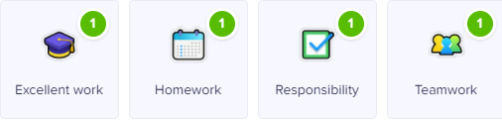

Class Dojo
Children can earn Dojo points for displaying any of the following:
Certificates will be presented if children reach the following milestones:
30 Dojos – Bronze
60 Dojos – Silver
100 Dojos – Gold
150 Dojos - Platinum

Slide 16
Science:
These are the science topics we cover in Year 3:
Rocks and soils
Plants (how they grow & parts of a plant)
Light (How we can see / sources of light & sun safety)
Forces and magnets
Animals including humans

Slide 17
End of day collection arrangements
Please let either your child’s class teacher or the school office know of any changes to collection arrangements.
For safeguarding reasons, we cannot let children go home with adults not on collection lists unless you have given us prior notification.
Please note that dogs (except guide dogs) are not permitted on the premises under any circumstances.

Slide 18
What can you do to help your child?
Listening to your child read and questioning them about what they have read.
Times tables need to be learned – the expectation for the end of Year 3 is to know the 2, 3, 4, 8 and 10 times tables.
Provide a quiet place and encouragement for homework to be completed.
Use Maths in everyday situations, ask your child to tell you the time, what will it be in …?
Encourage your child to be involved with money when shopping, using the right amount in coins etc.

Slide 19

Remember the school website for additional information.
www.williamhildyard.lincs.sch.uk

Slide 20






We are looking forward to a very positive year ahead.
Should you have any questions, please contact the school office via telephone or email and we will arrange a time to contact you.

