Slide 1

Year 4
Information for Parents and Carers

Slide 2
Staff working in Year 4
Mr Ramsay
PPA Cover (Thursday PM)
Mrs King (History)
Mr Troth (PE)
Mrs Dent – Teaching Assistant

Slide 3

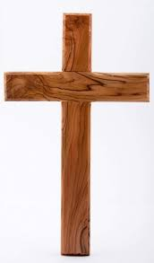

Worship
Worship will take place every day at 8:50am in the school hall. This will be led by different staff members, as well as representatives from St. Guthlac’s Church.
Merit worships take place on Friday mornings to celebrate individual children’s work and birthday celebrations are held on Fridays.

Slide 4
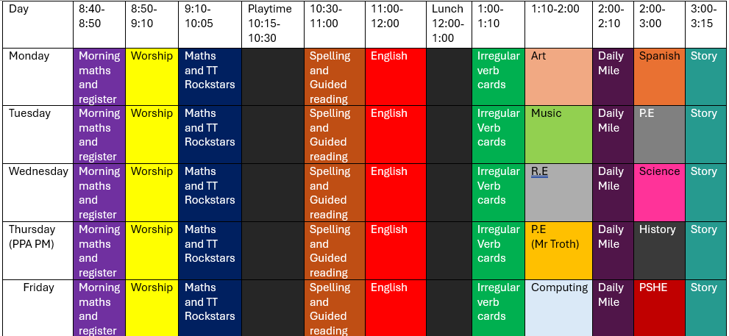
Year 4 Timetable:

Slide 5
What are the themes in Year 4?
Term 1 - Friendship
Term 2 – Generosity
Term 3 – Thankfulness
Term 4 – Forgiveness
Term 5 – Dignity
Term 6 – Wisdom

Slide 6
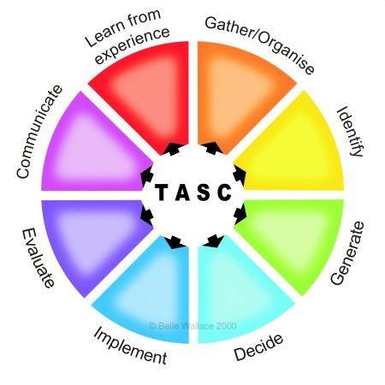
The children will be working on the Year 4 standards in the National Curriculum.
How do we judge how well your children are progressing?
Sharing learning objectives and success criteria together.
Questioning
Partners/Small group work
Self evaluation
TASC / Using and Applying
Guided groups
Recorded work
Summative assessment
Thinking actively in a social context
Notes:
thinking actively in a social context

Slide 7
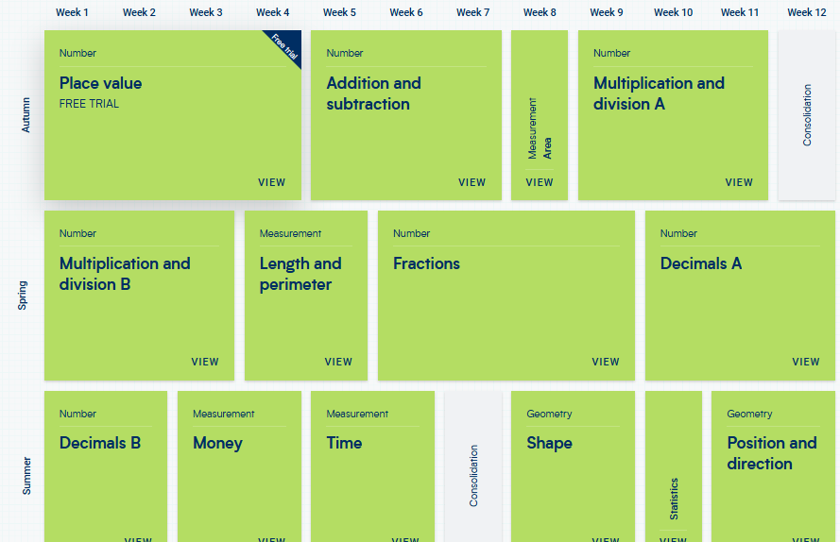
Maths:
These are the areas that the children will work on during Year 4.

Slide 8

Maths
For information on how we are teaching maths in school, please follow the link below.
School website –> Our Learning -> Maths support

Slide 9
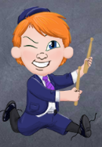
Multiplication
TT Rockstars:
Please use the Times Tables Rockstars app at home
to support your child with learning their tables.
This will be really helpful for prep towards the government MTC assessment in June next year.

Slide 10
Maths:
Properties of Number- Large numbers, place value, decimals
Addition and Subtraction- mental strategies and formal written methods
Problem solving, reasoning and algebra
Multiplication and Division – mental strategies and formal written methods
Ongoing practice of mental maths and arithmetic in
timed conditions
School website –> Our Learning -> Maths support

Slide 11
English: Term 1
Active English – focus on spelling, grammar and punctuation
Focus text: ‘Greta and the Giants and Greta’s autobiogrpahy
Text types and skills to be covered:
-Punctuation skills
Sentence structure
Biography wiritng
Summary
Fact gathering
Non- chronological report

Slide 12
Writing expectations for Year 4
Use a varying level of formality within writing
Use paragraphs to organise ideas
Use a range of sentence types (simple, compound, complex)
Use adverbs, prepositional phrases and expanded noun phrases
Use relative clauses
Punctuation
    capital letters, full stops, question marks, exclamation marks, commas for lists and apostrophes for contractions
    inverted commas for speech
    brackets, dashes or commas to indicate additional information
Plan, draft and re-draft with a particular focus on spelling.

Slide 13
Fearfully, hesitantly I tip-toed across the sea of blood-red roses that lay before me. Below my feet ran a crystal-clear stream, shimmering stones tossed and turned against the trickling current. All around me, trees towered and hovered watching me silently continue my journey. When would this so-called adventure end?
I couldn’t see in front of me. I couldn’t see behind me. Nor could I see the little girl. Silently she stood. Watching. Waiting. The fading light was quickly disappearing before my very eyes- I began to feel uneasy, terrified. Slowly, the girl turned to look at me a quizzical look on her face. As the fog silently rolled in she opened her voice to speak.
“Come closer, let me tell you my story…..”

Slide 14
Spelling expectations for Year 4
Use further prefixes and suffixes and understand the guidance for adding them
Spell some words with ‘silent’ letters (ex. knight, psalm, solemn)
Continue to distinguish between homophones (new & knew) and other words which are often confused
Use knowledge of morphology & etymology in spelling; understand that the spelling of some words needs to be learnt specifically (see spelling section below)
Use dictionaries to check the spelling and meaning of words
Use the first three or four letters of a word to check spelling, meaning or both of these in a dictionary
Use a thesaurus

Slide 15
History and Geography
Term 1 - How have children’s lives changed?
Term 2 – Why are Rainforests important to us?
Term 3 – What changed in Britian after the Anglo-Saxon invasion?
Term 4 – Where does our food come from?
Term 5 – How did the achievements of Maya influence their society and beyond.
Term 6 – What are rivers and how are they used?

Slide 16
Reading expectations for Year 4
- Read age-appropriate books with confidence and fluency (including whole novels)
- Read aloud with intonation that shows understanding
- Work out the meaning of words from the context
- Explain and discuss their understanding of what they have read, drawing inferences and justifying these with evidence
- Predict what might happen from details stated and implied
- Retrieve information from non-fiction
- Summarise main ideas, identifying key details and using quotations for illustration
- Evaluate how authors use language, including figurative language, considering the impact on the reader
- Make comparisons within and across books.

Slide 17
Homework
Homework will be handed out on Friday and should be completed by the following Wednesday.
Homework will be set for all children from Friday 11th September 2026.
Homework will include:
99 club sheet
Reading
Spelling list of words learnt in class that week
Regular Times Table Rockstars practise

Slide 18

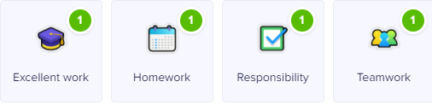

Class Dojo
Children can earn Dojo points for displaying any of the following:
Certificates will be presented if children reach the following milestones:
30 Dojos – Bronze
60 Dojos – Silver
100 Dojos – Gold
150 Dojos - Platinum

Slide 19

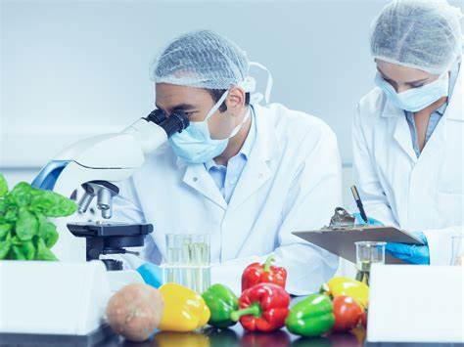
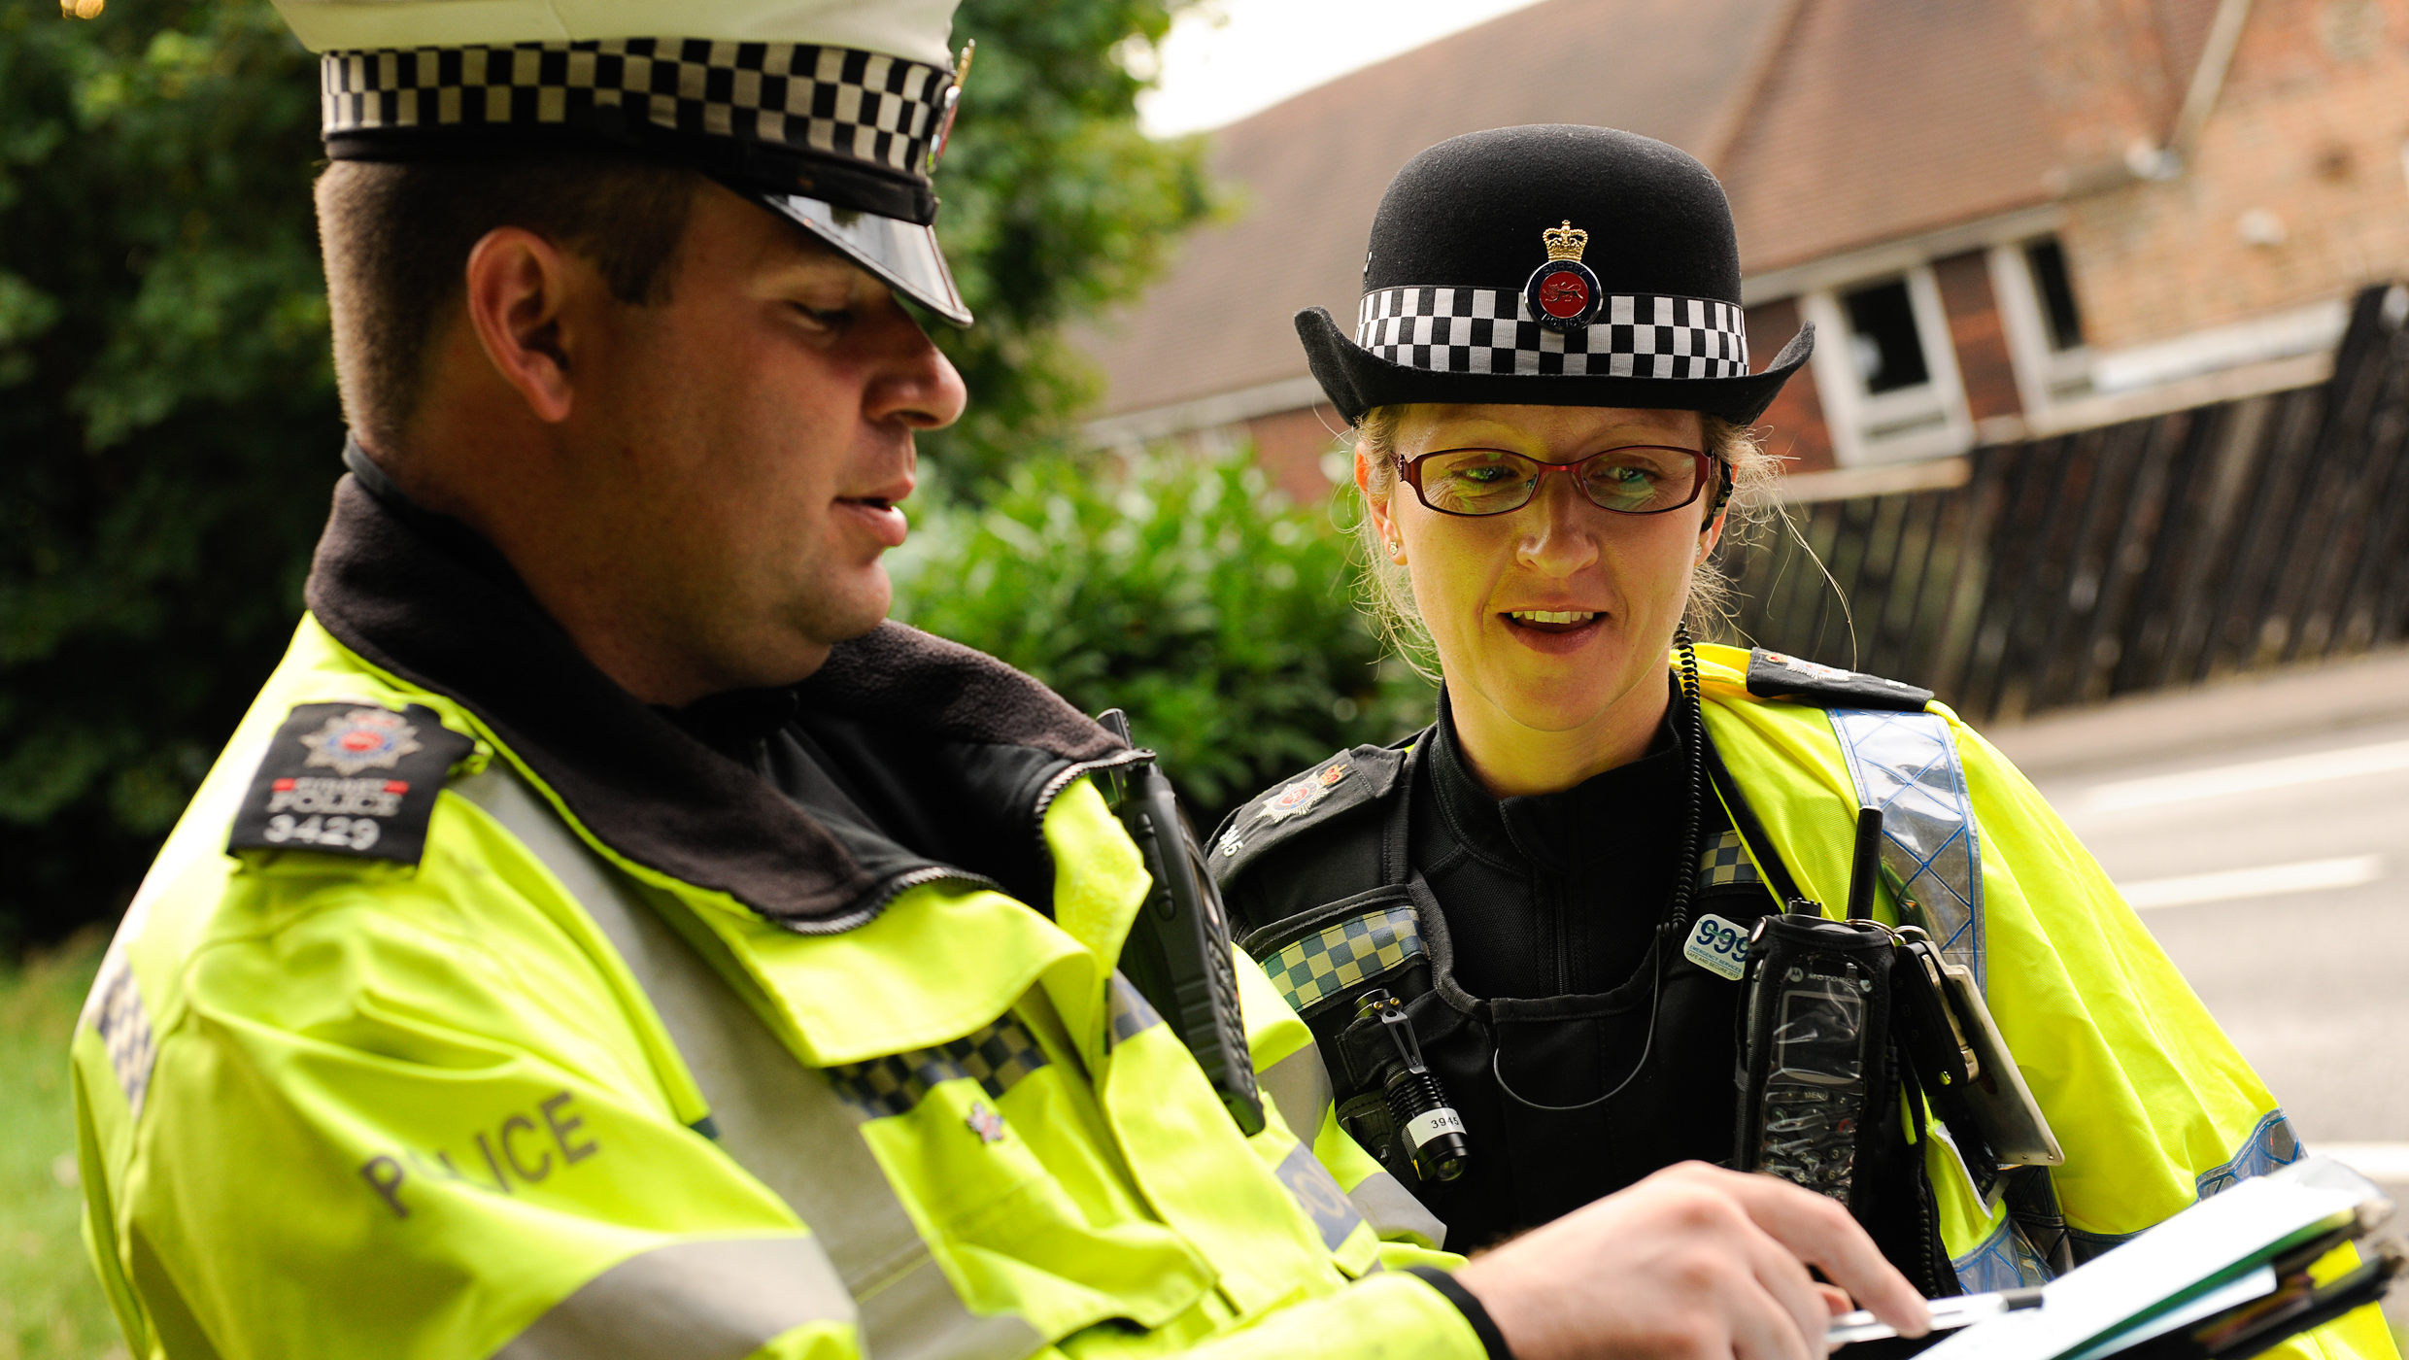
Aspirations
We are very keen to promote and enhance career aspirations for our children. To this end, we are exploring some of the careers that individual subjects could lead to.
Have a look at the booklets that have been produced by subject leaders to introduce the children to some of these careers…

Slide 20
Science:
Sound
Electricity
Living things and their habitats
States of matter
Animals including humans

Slide 21
Key Assessment Dates:
Year 1 Phonics Screening
To take place during 14th – 18th June 2027
Year 4 Multiplication Tables Check
To take place during the period of Monday 7th June – Friday 11th June 2027
Year 6 SATs
10th – 14th May 2027

Slide 22
Collection arrangements
Please let either your child’s class teacher or the school office know of any changes to collection arrangements.
For safeguarding reasons, we cannot let children go home with adults not on collection lists unless you have given us prior notification.
Please note that dogs (except guide dogs) are not permitted on the premises under any circumstances.

Slide 23
Homework
Mr Ramsay will give homework out on a Friday which will consist of Maths and spelling. This will be a combination of work on 99 club sheets and spelling list. This will be returned on the following Wednesday.
Children have also been asked to complete at least 15 minutes of TT Rockstars a day.
The amount of time that we ask pupils to spend on their homework in Year 4 equates to approximately 30 min a day.

Slide 24
What can you do to help your child?
Listening to your child read and questioning them about what they have read.
Times tables need to be learned – the expectation for the end of Year 3 is to know the 2, 3, 4, 8 and 10 times tables.
Times Table Rock Stars can be practised at home.
Provide a quiet place and encouragement for homework to be completed.
Use Maths in everyday situations, ask your child to tell you the time, what will it be in …?
Encourage your child to be involved with money when shopping, using the right amount of coins etc.

Slide 25
Remember the school website for additional information.
www.williamhildyard.lincs.sch.uk

Slide 26
We are looking forward to a very positive year ahead. Should you have any questions, please contact the school office via telephone or email and we will arrange a time to contact you.

