Slide 1

Year 4
Information for Parents and Carers

Slide 2
Staff working in Year 4
Mr Ramsay
PPA Cover (Wednesday PM)
Mrs Snart ( Music)
Mr Troth (PE)
– Teaching Assistant
Mrs Allen

Slide 3



Worship
Worship will take place every day at 8:50am in the school hall. This will be led by different staff members, as well as representatives from St. Guthlac’s Church.
Merit worships take place on Monday mornings to celebrate individual children’s work and birthday celebrations are held on Thursdays.

Slide 4
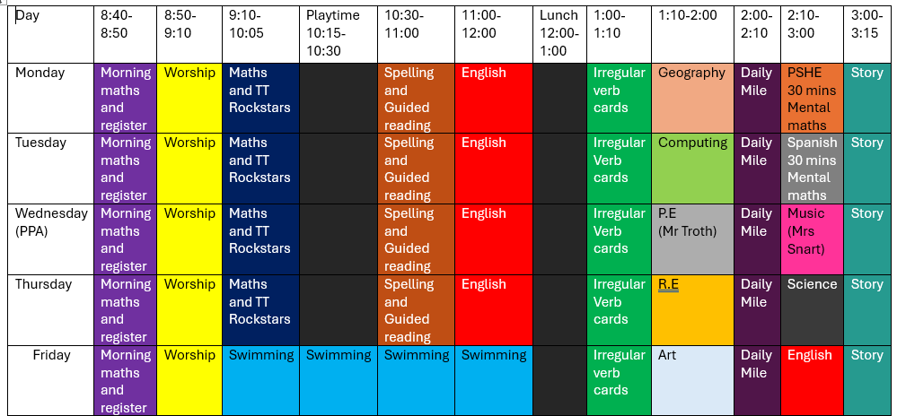
Year 4 Timetable:

Slide 5
What are the themes in Year 4?
Term 1 - Why are rainforests important to us?
Term 2 – The Mayan civilisation
Term 3 – How have children’s lives changed
Term 4 – Where does our food come from?
Term 5 – Invaders and settlers
Term 6 – What are rivers and how are they used?

Slide 6
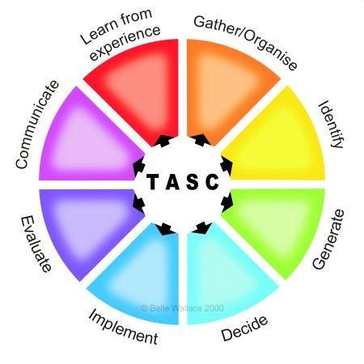
The children will be working on the Year 4 standards in the National Curriculum.
How do we judge how well your children are progressing?
Sharing learning objectives and success criteria together.
Questioning
Partners/Small group work
Self evaluation
TASC / Using and Applying
Guided groups
Recorded work
Summative assessment
Thinking actively in a social context
Notes:
thinking actively in a social context

Slide 7
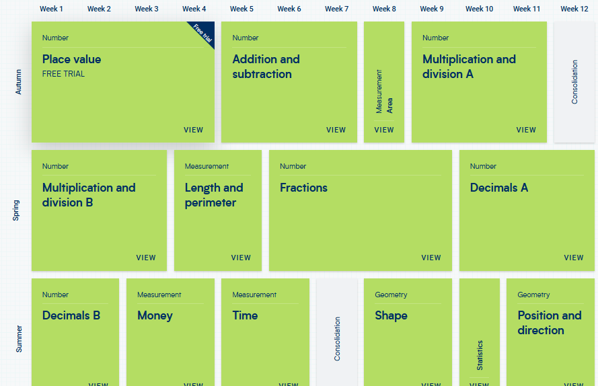
Maths:
These are the areas that the children will work on during Year 4.

Slide 8

Maths
For information on how we are teaching maths in school, please follow the link below.
School website –> Our Learning -> Maths support

Slide 9
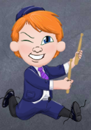
Multiplication
TT Rockstars:
Please use the Times Tables Rockstars app at home
to support your child with learning their tables.

Slide 10
Maths:
Place value
Addition and Subtraction- mental strategies and formal written methods
Measurement, area
Multiplication and Division – mental strategies and formal written methods
Ongoing practice of mental maths and arithmetic in
timed conditions.
- Timestable practice
School website –> Our Learning -> Maths support

Slide 11
English: Term 1
Active English – focus on spelling, grammar and punctuation
Focus text: Greta Thundberg biography and reports about rainforests
Text types and skills to be covered:
-Formal report writing – gathering accurate and factual information for reports
-Note taking etc.
-Fact files - On people , places and events.
-Chronological writing .
-Report and journalistic writing – use of formal and informal language.

Slide 12
Writing expectations for Year 4
Use a varying level of formality within writing
Use paragraphs to organise ideas
Use a range of sentence types (simple, compound, complex)
Use adverbs, prepositional phrases and expanded noun phrases
Use relative clauses
Punctuation
    capital letters, full stops, question marks, exclamation marks, commas for lists and apostrophes for contractions
    inverted commas for speech
    brackets, dashes or commas to indicate additional information
Plan, draft and re-draft with a particular focus on spelling.

Slide 13
Greta Thundberg
Scientific evidence from the last thirty years shows us that carbon emissions and the destruction of habitats have led to terrible consequences for the planet. This drove Greta Thunberg into action and onto our screens. This young activist uses her voice to campaign against behaviours that damage planet Earth the most.
Childhood
Greta was born in Stockholm in Sweden in 2003. Both of her parents were entertainers as her mother was an opera singer and her father an actor. When she was eight years old, she heard about climate change for the first time. She just couldn’t understand why governments, big companies and ordinary people were not doing enough to stop it. After this, she suffered with her mental health. At age 11, she was diagnosed with Asperger’s Syndrome, OCD and selective mutism. Even though she might have felt different at times, she believes it is her superpower. Greta claims she only speaks when it is really needed, and climate change is definitely worth talking about.

Slide 14
Spelling expectations for Year 4
use further prefixes and suffixes and understand the guidance for adding them
spell some words with ‘silent’ letters (ex. knight, psalm, solemn)
continue to distinguish between homophones (new & knew) and other words which are often confused
use knowledge of morphology & etymology in spelling; understand that the spelling of some words needs to be learnt specifically (see spelling section below)
use dictionaries to check the spelling and meaning of words
use the first three or four letters of a word to check spelling, meaning or both of these in a dictionary
use a thesaurus

Slide 15
Reading expectations for Year 4
- read age-appropriate books with confidence and fluency (including whole novels)
- read aloud with intonation that shows understanding
- work out the meaning of words from the context
- explain and discuss their understanding of what they have read, drawing inferences and justifying these with evidence
- predict what might happen from details stated and implied
- retrieve information from non-fiction
- summarise main ideas, identifying key details and using quotations for illustration
- evaluate how authors use language, including figurative language, considering the impact on the reader
- make comparisons within and across books.

Slide 16
Homework
Homework will be set online this year via Purple Mash and homework books. We have used Purple Mash successfully for remote learning and homework previously and this is a format that the children are used to. Homework will be uploaded to Purple Mash each Friday and should be completed by the following Wednesday.
Homework will be set for all children from Friday 12th September 2025.
Homework will include:
Reading activity on Serial Mash
1 x maths and grammar activity in homework books
Regular Times Table Rockstars practise

Slide 17

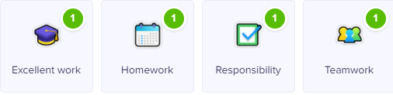

Class Dojo
Children can earn Dojo points for displaying any of the following:
Certificates will be presented if children reach the following milestones:
30 Dojos – Bronze
60 Dojos – Silver
100 Dojos – Gold
150 Dojos - Platinum

Slide 18

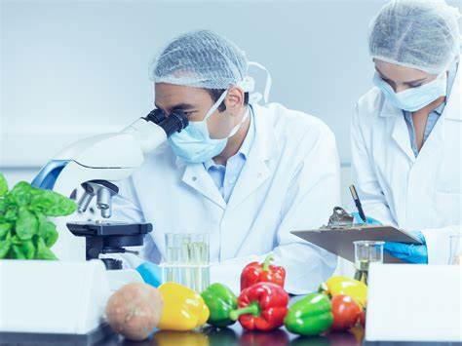
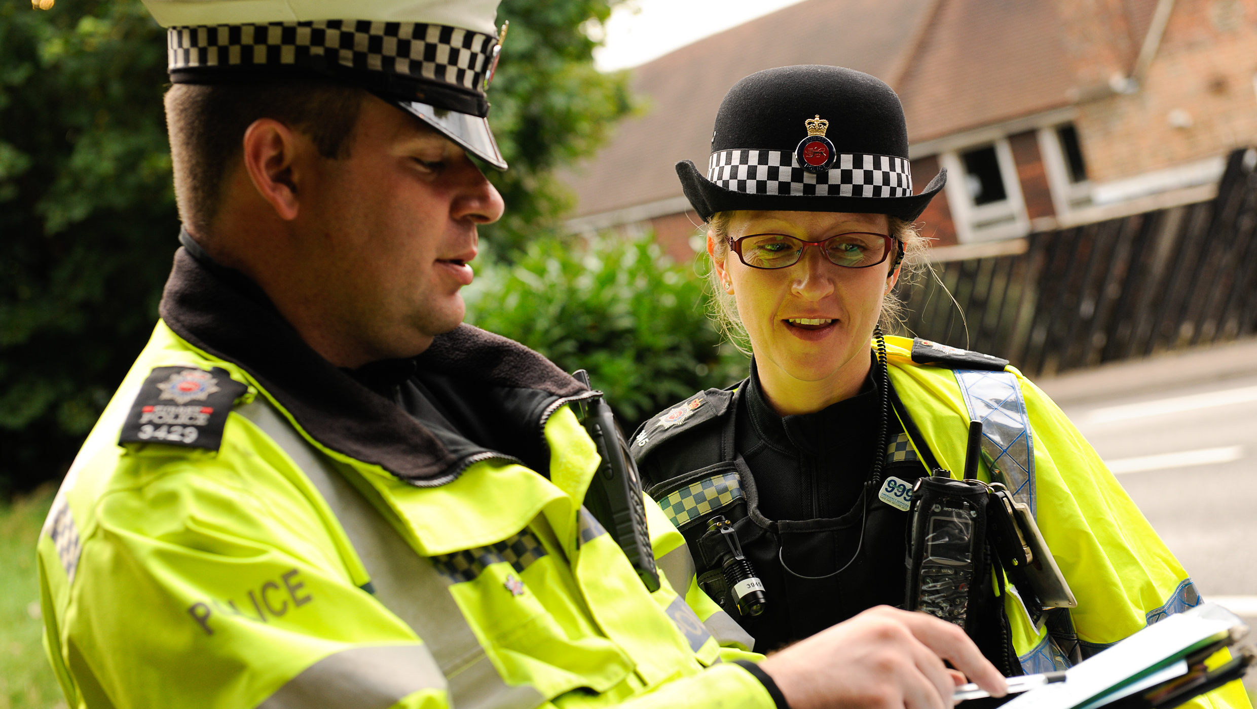
Aspirations
We are very keen to promote and enhance career aspirations for our children. To this end, we are exploring some of the careers that individual subjects could lead to.
Have a look at the booklets that have been produced by subject leaders to introduce the children to some of these careers…

Slide 19
Science:
Living things and their habitats
Changing states
Electricity
Sound
Animals including humans

Slide 20
Key Assessment Dates:
Year 1 Phonics Screening
To take place during the week commencing Monday 8th -12th June 2026
Year 4 Multiplication Tables Check
To take place during the period of Monday 8th June – Friday 12th June 2026
Year 6 SATs
11th- 15th May 2026

Slide 21
Collection arrangements
Please let either your child’s class teacher or the school office know of any changes to collection arrangements.
For safeguarding reasons, we cannot let children go home with adults not on collection lists unless you have given us prior notification.
Please note that dogs (except guide dogs) are not permitted on the premises under any circumstances.

Slide 22
Homework
Mr Ramsay will give homework out on a Friday which will consist of Maths and English. This will be a combination of work on Purple Mash and CGP books. This will be returned on the following Wednesday.
Children have also been asked to complete at least 4 Read Theory quizzes per week and complete 15 minutes of TT Rockstars a day.
The amount of time that we ask pupils to spend on their homework in Year 4 equates to approximately 30 min a day.

Slide 23
What can you do to help your child?
Listening to your child read and questioning them about what they have read.
Times tables need to be learned – the expectation for the end of Year 3 is to know the 2, 3, 4, 8 and 10 times tables.
Times Table Rock Stars can be practised at home.
Provide a quiet place and encouragement for homework to be completed.
Use Maths in everyday situations, ask your child to tell you the time, what will it be in …?
Encourage your child to be involved with money when shopping, using the right amount of coins etc.

Slide 24
Remember the school website for additional information.
www.williamhildyard.lincs.sch.uk

Slide 25
We are looking forward to a very positive year ahead. Should you have any questions, please contact the school office via telephone or email and we will arrange a time to contact you.

