Slide 1

Welcome to the
Year 5
Information Evening

Slide 2
The Year 5 Team
Mrs Gray - Class Teacher
Mrs Snart – Music
Mr Troth - Games
Our Teaching Assistants
Miss Binu

Slide 3

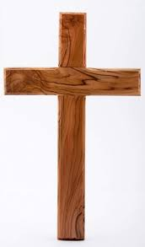

Worship
Worship will take place every day at 8.50 am in the school hall. This will be led by different staff members, as well as representatives from St. Guthlac’s Church.
‘Let your light shine’ worships take place on Monday mornings to celebrate individual children’s work.

Slide 4
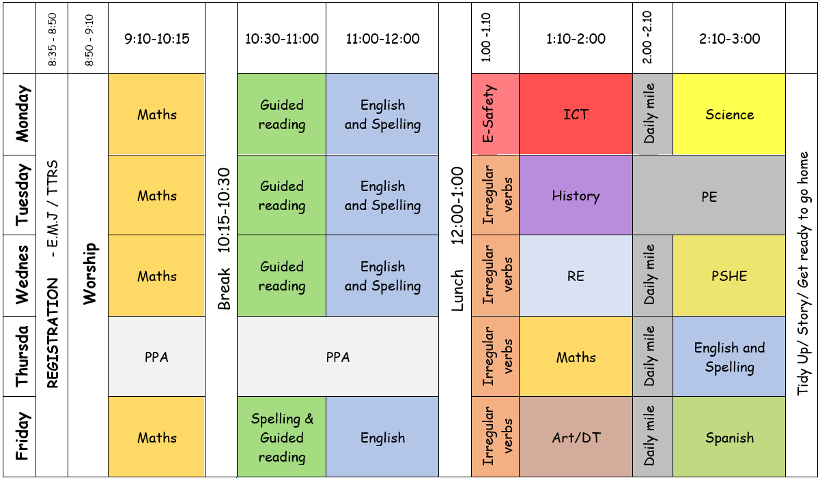
Year 5 Timetable
Weekly Timetable

Slide 5
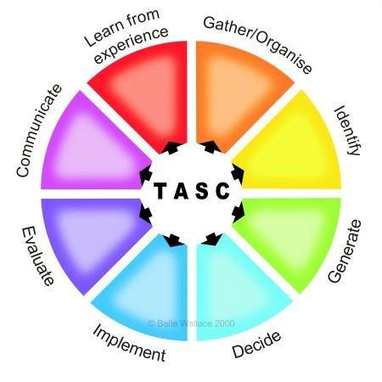
The children will be working on the Year 5 standards in the National Curriculum.
How do we judge how well your children are progressing?
Sharing learning objectives and success criteria together.
Questioning
Partners/Small group work
Self-evaluation
TASC/ Using and Applying
Guided groups
Recorded work
Summative assessment
Thinking Actively in a Social Context

Slide 6
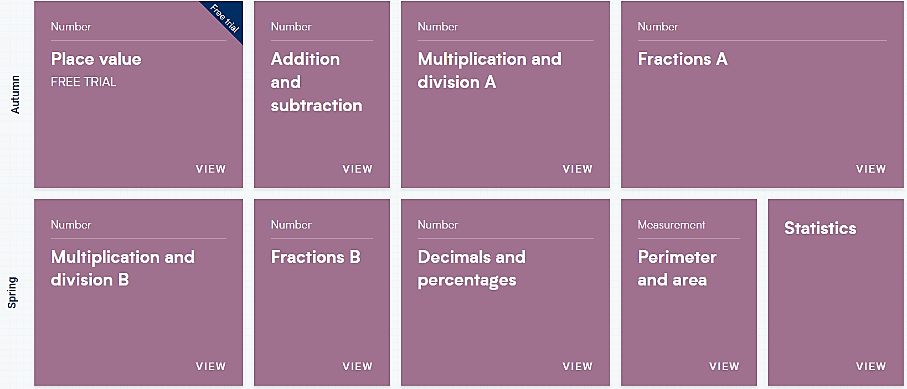
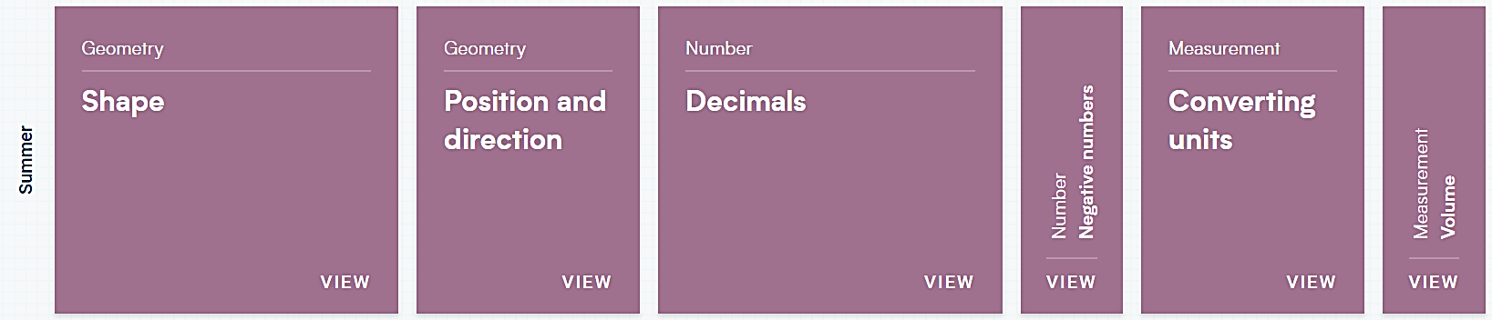
Maths:
These are the areas that the children will work on during Year 5.

Slide 7

Maths
For information on how we are teaching maths in school, please follow the link below.
School website –> Our Learning -> Maths support

Slide 8
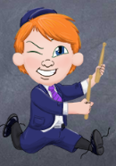
Multiplication
TT Rockstars:
Please use the Times Tables Rockstars app at home
to support your child with learning their tables.
By Year 5 children are expected to recall all their Times Tables.
Please ensure that children continue to practise their times tables throughout Year 5. This will ensure they can quickly recall these multiplication facts. They are used in many areas of their maths work including multiplication, fractions and measure.
A times table test will happen weekly.

Slide 9
Grammarsaurus English:
The sequence of work will begin with looking at the features of the text. They will practise the grammar to be used and consider the vocabulary they might use. Children will then plan their own ideas. Drafting and Editing will then follow. A final piece will be written.
Focus text: ‘Midnight Fox’ by Betsy Byars
Term 1
Place Value for Punctuation and Grammar PVPG
Recalling and learning key grammar which will be used throughout the year.
Narrative
Learning about the features of a Heroic Pursuit narrative. Then planning and writing a narrative with a Viking theme.
Non-Chronological reports
Learning about the features of a non-chronological report. Writing informative pages about planets using commas, conjunctions and writing in paragraphs
Non-fiction Non-chronological Reports
Use example texts about iPads and iPhones to introduce features of non-chronological reports. Identify key features of the genre. Use texts to study grammar features-paragraphs, expanded noun phrases, pronouns, embedded clauses. Children research and create a page for a class book about planets.
Non-fiction Biographies and autobiographies
Use biographies of Roald Dahl (Boy) and Michael Morpurgo (Homecoming) and their autobiographical writing to identify features of biographies and autobiographies. Use the texts to study dialogue, noun phrases and complex sentences. Children write biography about a famous astronaut.
Non-fiction Reports and Journalistic Writing
Look at real examples of newspaper reports on Moon landing. Look at different ways of writing speech – play scripts, speech bubbles, direct and reported speech. Compare formal and informal writing including use of passive voice. e.g. it was launched as opposed to the active form they launched it ). Children write newspaper reports about the Moon landing.
Fiction Science fiction
COSMIC– science fiction Tales from Outer Suburbia by Shaun Tan, Templar Publishing. Children read and analyse a selection of short stories from Tales of Outer Suburbia by Shaun Tan. They explore the structure of short stories and the use of modal verbs and dialogue. Children write a drama based on one they have heard and then a new story .

Slide 10
Writing expectations for Year 5
Use paragraphs to organise ideas
Use a range of sentence types (simple, compound, complex)
Use adverbs, prepositional phrases and expanded noun phrases
Use relative clauses (embedded clauses)
Punctuation
    capital letters, full stops, question marks, exclamation marks, commas for lists and apostrophes for contractions
    inverted commas for speech
    brackets, dashes or commas to indicate additional information
Plan, draft and re-draft
Choose own genre to represent information in Topic, RE or Science

Slide 11
Spelling expectations for year 5:
Learn and use the Statutory Year 5/6 spellings.
We learn new spelling rules over a week in our Active Spelling lessons.
Use further prefixes and suffixes and understand the guidance for adding them
Spell some words with ‘silent’ letters (ex. knight, psalm, solemn)
Continue to distinguish between homophones (new & knew) and other words which are often confused
Use knowledge of morphology (how words are formed) & etymology (origin of the word) in spelling; understand that the spelling of some words needs to be learnt specifically
Use dictionaries to check the spelling and meaning of words
Use the first three or four letters of a word to check spelling, meaning or both of these in a dictionary
Use a thesaurus

Slide 12
Term 1 Where the Viking raiders, traders or
something else?
(History)
Term 2 What is life like in the Alps?
(Geography)
Term 3 What was life like in Tudor England?
(History)
Term 4 Why do oceans matter?
(Geography)
Term 5 What did the Greeks ever do for us?
(History)
Term 6 Would you like to live in the desert?
(Geography)
What are the themes in Year 5?

Slide 13
Year 5 spelling patterns:
The children in Years 2 – 6 will take part in daily spelling lessons, following the Active Spelling scheme of work (produced by the L.E.A.D. Teaching School Hub).
Spelling patterns/rules taught include:
Words ending in –ant, –ance/–ancy, –ent, –ence/–ency
Words ending in –ible and –able including –ably and –ibly
Adding suffixes to words ending in –fer,
Using prefixes co- and re-
Words with the /i:/ sound spelt ei after c
Words containing the letter-string ough
Silent letters – k, w, b, t, h, s
Homophones and near homophones
selected words from the statutory spelling list for Years 5 and 6

Slide 14
Reading expectations for Year 5
read age - appropriate books with confidence and fluency
(including whole novels)
- read aloud with intonation that shows understanding
- work out the meaning of words from the context
explain and discuss their understanding of what they have read,
drawing inferences and justifying these with evidence
predict what might happen from details stated and implied
- retrieve information from non-fiction
summarise main ideas, identifying key details and using
quotations for illustration
evaluate how authors use language, including figurative
language, considering the impact on the reader
- make comparisons within and across books.

Slide 15
How can you help your child with their reading at home?
Encourage your child to read for at least 20 mins a day where possible (min 20 mins 4 x per week)
Share books together – you reading to your child and them reading to you
Discuss the books that your child is reading
Encourage your child to read longer, more age-appropriate books
Encourage your child to read for longer periods of time to build stamina
Read a broad range of texts, including non-fiction.

Slide 16
Science
Science investigations will be undertaken on a regular basis throughout the topics covered.
Children will develop skills by:
posing scientific questions,
predicting outcomes,
devising fair tests,
testing,
recording results
drawing conclusions.

Slide 17
Science
Topics in Year 5 are:
Earth and Space
Forces
Properties and Changes of Materials
Animals including Humans
Living things and their Habitats

Slide 18
Key Assessment dates:
Year 6 SATS week
To take place during the week commencing Monday, May 11th to Thursday, May 14th, 2026
Year 4 Multiplication Tables Check
To take place in the 2 weeks from Monday 1st June 2026
Phonics Screening
To take place during the week commencing Monday 8th June 2026

Slide 19

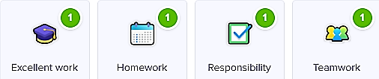

Class Dojo
Children can earn Dojo points for displaying any of
the following:
Certificates will be presented if children reach the following milestones:
30 Dojos – Bronze
60 Dojos – Silver
100 Dojos – Gold
150 Dojos - Platinum

Slide 20
Collection arrangements
Please let either your child’s class teacher or the school office know of any changes to collection arrangements.
For safeguarding reasons, we cannot let children go home with adults not on collection lists unless you have given us prior notification.
Please note that dogs (except guide dogs) are not permitted on the premises under any circumstances.

Slide 21

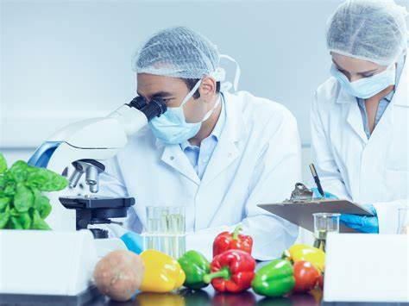
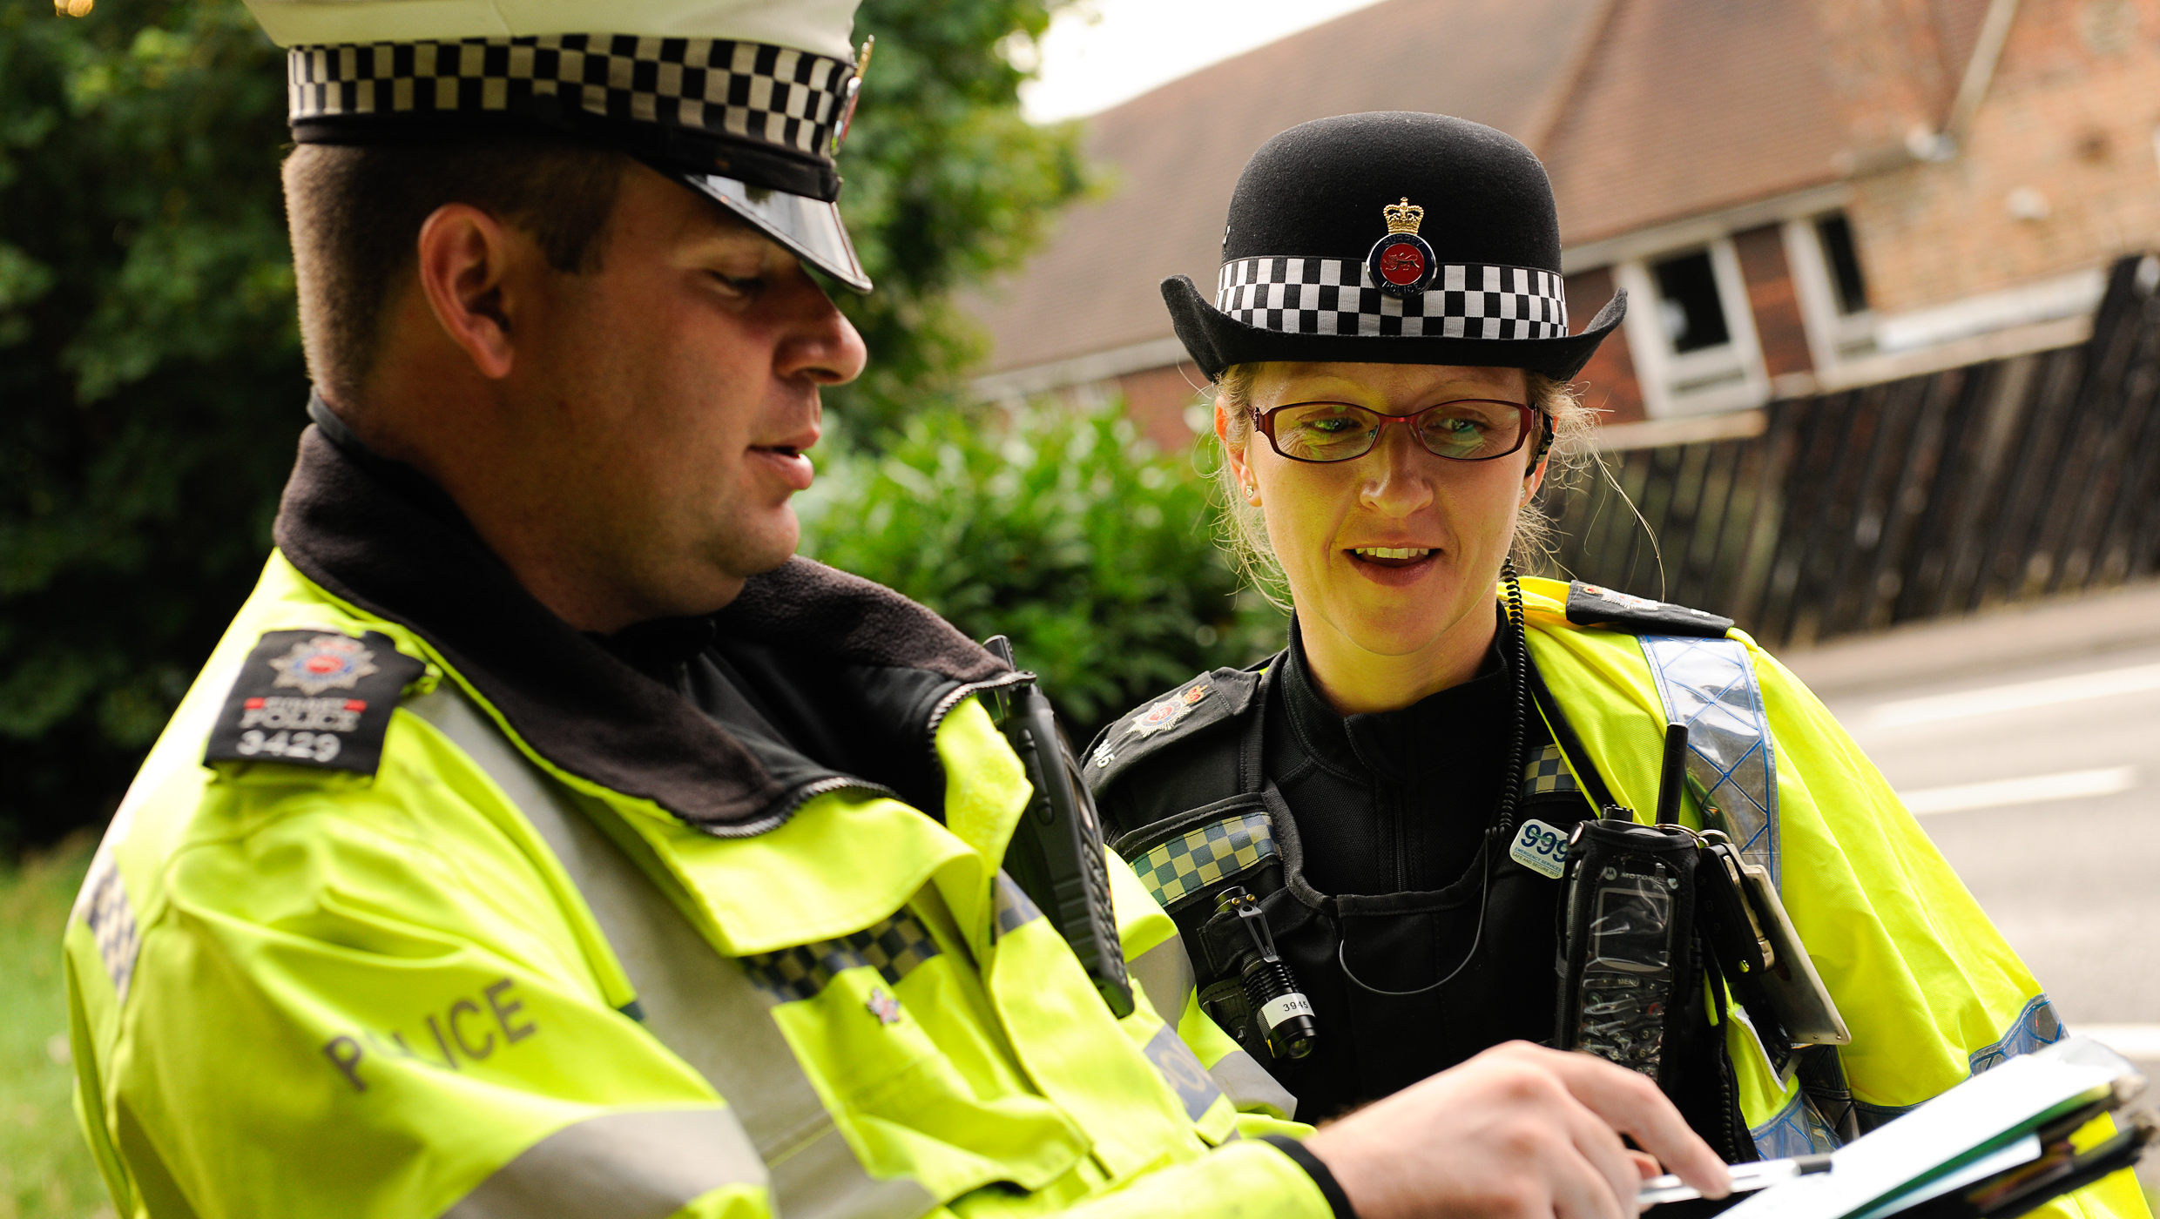
Aspirations
We are very keen to promote and enhance career aspirations for our children. To this end, we are exploring some of the careers that individual subjects could lead to.
Have a look at the booklets that have been produced by subject leaders to introduce the children to some of these careers…

Slide 22
Homework
Homework will be uploaded to Purple Mash each Friday and should be completed by the following Wednesday.
Homework will include:
1 chapter and reading quiz on Serial Mash
1 maths activity on Purple Mash or a White Rose worksheet
1 English activity or a grammar game
Regular Times Table Rockstars practise
Home reading

Slide 23
What can you do to help your child?
Provide a quiet place to work on homework tasks away from distractions.
Listen to your child read and question them about what they have read (e.g. prediction or language features)
Encourage your child to learn Times tables– part of the SATs next year
Use numbers (large ones) where possible.
Use Maths in everyday situations, ask your child to tell you the time, what will it be in …?
Use and talk about measurements in cooking, DIY, gardening, travel etc.
Encourage your child to be involved with money when shopping, using the right amount of coins etc.

Slide 24
Useful information
Games and PE - Tuesday with Mrs Gray and Thursday with
Mr Troth
Children will need to wear trainers and tracksuit bottoms on Thursday for Games and PE when the weather is colder.
Please ensure that hair is tied back, and earrings are removed on these days.
Children need to bring their water bottles containing water (not squash) every day.
Please keep big bags to a minimum as we do not have room to store things that do not fit in lockers.

Slide 25
Remember the school website for additional information.
www.williamhildyard.lincs.sch.uk

Slide 26
We look forward to an exciting year ahead!
Thank you for your time.

