Slide 1

Year 6
Information for Parents and Carers

Slide 2
Staff working in Year 6
Miss Bird
PPA Cover (Thursday AM)
Mr Troth (PE)
Miss Snart (Music)
Mr Troth, Miss Smitheringale/ Miss Nimmo– Teaching Assistants

Slide 3

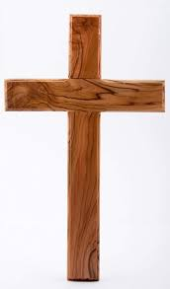

Worship
Worship will take place every day at 8:50am in the school hall. This will be led by different staff members, as well as representatives from St. Guthlac’s Church.
Merit worships take place on Monday mornings to celebrate individual children’s work and birthday celebrations are held on Thursdays.

Slide 4
Year 6 Timetable:

Slide 5
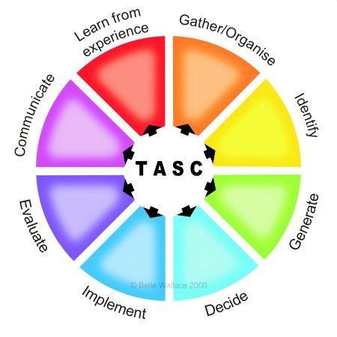
The children will be working on the Year 6 standards in the National Curriculum.
How do we judge how well your children are progressing?
Sharing learning objectives and success criteria together.
Questioning
Partners/Small group work
Self evaluation
Guided groups
Recorded work
Summative assessment
Thinking actively in a social context
Notes:
thinking actively in a social context

Slide 6
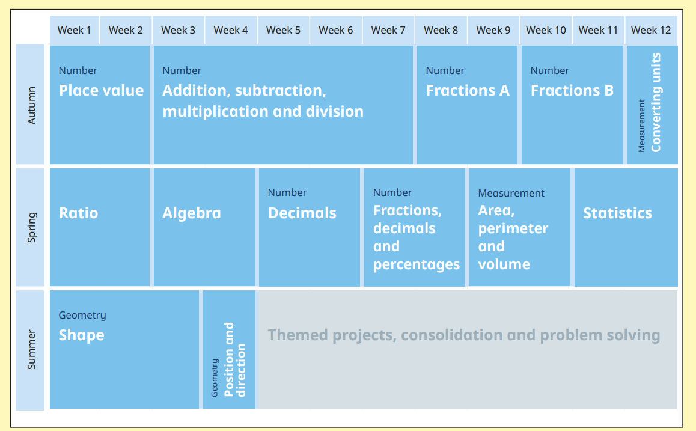
Maths:
These are the areas that the children will work on during Year 6.

Slide 7
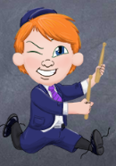
Multiplication
TT Rockstars:
Please use the Times Tables Rockstars app at home
to support your child with learning their tables.

Slide 8
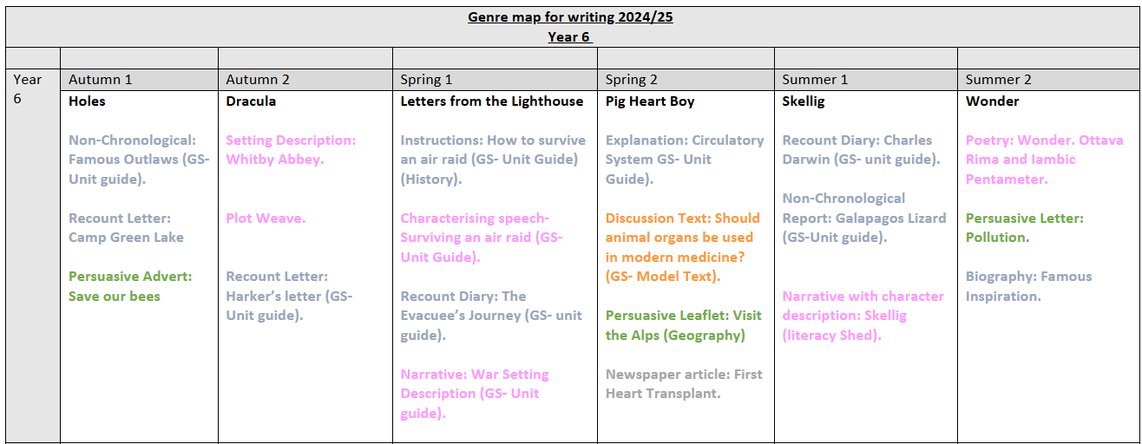

Slide 9
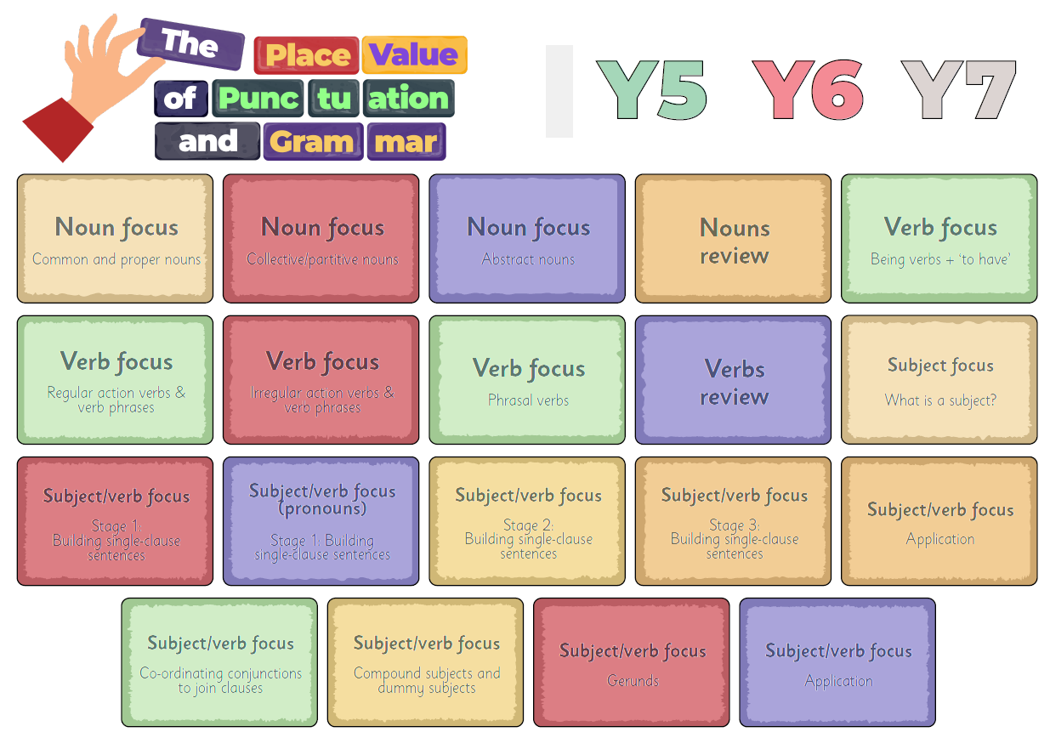
English: Term 1
Followed by an application unit (non-Chronological report) based on Famous Outlaws.

Slide 10
Writing expectations for Year 6
Use a varying level of formality within writing
Use paragraphs to organise ideas
Use a range of sentence types (simple, compound, complex)
Use adverbs, prepositional phrases and expanded noun phrases
Use relative clauses
Punctuation
    capital letters, full stops, question marks, exclamation marks, commas for lists and apostrophes for contractions
    inverted commas for speech
    brackets, dashes or commas to indicate additional information
Plan, draft and re-draft with a particular focus on spelling.

Slide 11
Fearfully, hesitantly I tip-toed across the sea of blood-red roses that lay before me. Below my feet ran a crystal clear stream, shimmering stones tossed and turned against the trickling current. All around me, trees towered and hovered watching me silently continue my journey. When would this so-called adventure end?
I couldn’t see in front of me. I couldn’t see behind me. Nor could I see the little girl. Silently she stood. Watching. Waiting. The fading light was quickly disappearing before my very eyes- I began to feel uneasy, terrified. Slowly, the girl turned to look at me a quizzical look on her face. As the fog silently rolled in she opened her voice to speak.
“Come closer, let me tell you my story…..”

Slide 12
Spelling expectations for Year 6
use further prefixes and suffixes and understand the guidance for adding them
spell some words with ‘silent’ letters (ex. knight, psalm, solemn)
continue to distinguish between homophones (new & knew) and other words which are often confused
use knowledge of morphology & etymology in spelling; understand that the spelling of some words needs to be learnt specifically (see spelling section below)
use dictionaries to check the spelling and meaning of words
use the first three or four letters of a word to check spelling, meaning or both of these in a dictionary
use a thesaurus

Slide 13
Reading expectations for Year 6
read age-appropriate books with confidence and fluency (including whole novels)
read aloud with intonation that shows understanding
work out the meaning of words from the context
explain and discuss their understanding of what they have read, drawing inferences and justifying these with evidence
predict what might happen from details stated and implied
retrieve information from non-fiction
summarise main ideas, identifying key details and using quotations for illustration
evaluate how authors use language, including figurative language, considering the impact on the reader
make comparisons within and across books.

Slide 14
Homework
Homework will be set online via Purple Mash. Homework will be uploaded to Purple Mash each Friday and should be completed by the following Wednesday.
Homework will be set for all children from Friday 12th September 2025.
Homework will include:
Reading activity on Serial Mash
1 x maths and grammar activity.
Regular Times Table Rockstars practise

Slide 15

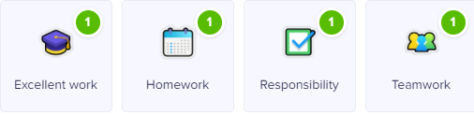

Class Dojo
Children can earn Dojo points for displaying any of the following:
Certificates will be presented if children reach the following milestones:
30 Dojos – Bronze
60 Dojos – Silver
100 Dojos – Gold
150 Dojos - Platinum

Slide 16
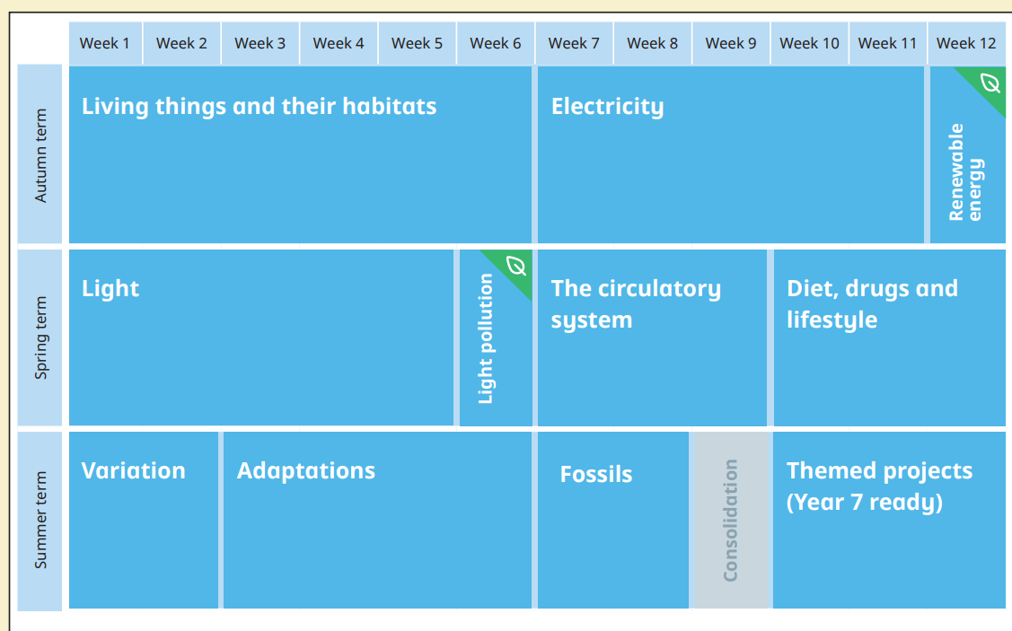
Science:

Slide 17
Key Assessment Dates:
Year 1 Phonics Screening
To take place during the week commencing Monday 9th June 2025
Year 4 Multiplication Tables Check
To take place during the week commencing Monday 2nd June 2025
Year 6 SATs
Monday 12th May – Thursday 15th May 2025

Slide 18
Collection arrangements
Please let either your child’s class teacher or the school office know of any changes to collection arrangements.
For safeguarding reasons, we cannot let children go home with adults not on collection lists unless you have given us prior notification.
Please note that dogs (except guide dogs) are not permitted on the premises under any circumstances.

Slide 19
What can you do to help your child?
Listening to your child read and questioning them about what they have read.
Times tables need to be learned – the expectation for the end of Year 3 is to know the 2, 3, 4, 8 and 10 times tables.
Times Table Rock Stars can be practised at home.
Provide a quiet place and encouragement for homework to be completed.
Use Maths in everyday situations, ask your child to tell you the time, what will it be in …?
Encourage your child to be involved with money when shopping, using the right amount of coins etc.

Slide 20
Remember the school website for additional information.
www.williamhildyard.lincs.sch.uk

Slide 21
We are looking forward to a very positive year ahead. Should you have any questions, please contact the school office via telephone or email and we will arrange a time to contact you.

