Slide 1

Year 4
Information for Parents and Carers

Slide 2
Staff working in Year 4
Mrs Howard-Class Teacher
PPA Cover (Wednesday AM)
Miss Remnant (PSHE)
Mrs Oakley (PE)
Mr Troth (PE)
Mrs Allen– Teaching Assistant

Slide 3

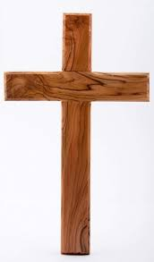

Worship
Worship will take place every day at 8:50am in the school hall. This will be led by different staff members, as well as representatives from St. Guthlac’s Church.
Merit worships take place on Monday mornings to celebrate individual children’s work and birthday celebrations are held on Thursdays.

Slide 4
Year 4 Timetable:
 | 8.40 – 8.50 | 8.50-9.10 | Session 1 9.10 – 10.05 | Play Time 10.05 – 10.20 | Session 2 10.20 – 11.00 | Session 3 11.00 – 12.00 | Lunch 12.00 – 1.00 | 1.00 – 1.10 | Session 4 1.10 – 2.10 | 2.10 – 3.00 | 3.00 – 3.15
Monday | Morning maths & Register | Worship | Maths and TT rock stars |  | Spelling and guided reading | English |  | Irregular verbs cards | RE | Music | Story
Tuesday | Morning maths & Register | Worship | Maths TT rock stars |  | Spelling and guided reading | English |  | Irregular verbs cards | Computing | science | Story
Wednesday | Morning maths & Register | Worship | Maths TT rock stars |  | Spelling and guided reading | English |  | PPA Alternate with mornings every other term | PPA | PPA
Thursday | Morning maths & Register | Worship | Maths TT rock stars |  | Spelling and guided reading | English |  | Irregular verbs cards | Geography | Art | Story
Friday | Morning maths & Register | Worship | Maths TT rock stars |  | Spelling and guided reading | English |  | Irregular verbs cards | DT | Spanish | Story

Slide 5
What are the Geography and History topics in Year 4?
Term 1 - Who lives in Antarctica?
Term 2 - How did achievements of the Maya civilisation influence their society and beyond.
Term 3 - How different were the beliefs in Ancient Egypt?
Term 4 - Road trip USA
Term 5 - How hard was is it to invade and settle in Britain
Term 6 – What are rivers and how they are used?

Slide 6
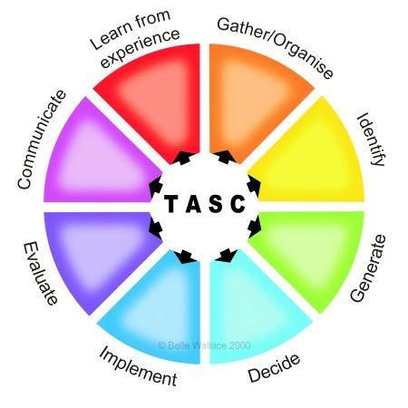
The children will be working on the Year 4 standards in the National Curriculum.
How do we judge how well your children are progressing?
Sharing learning objectives and success criteria together.
Questioning
Partners/Small group work
Self evaluation
TASC / Using and Applying
Guided groups
Recorded work
Summative assessment
Thinking actively in a social context
Notes:
thinking actively in a social context

Slide 7
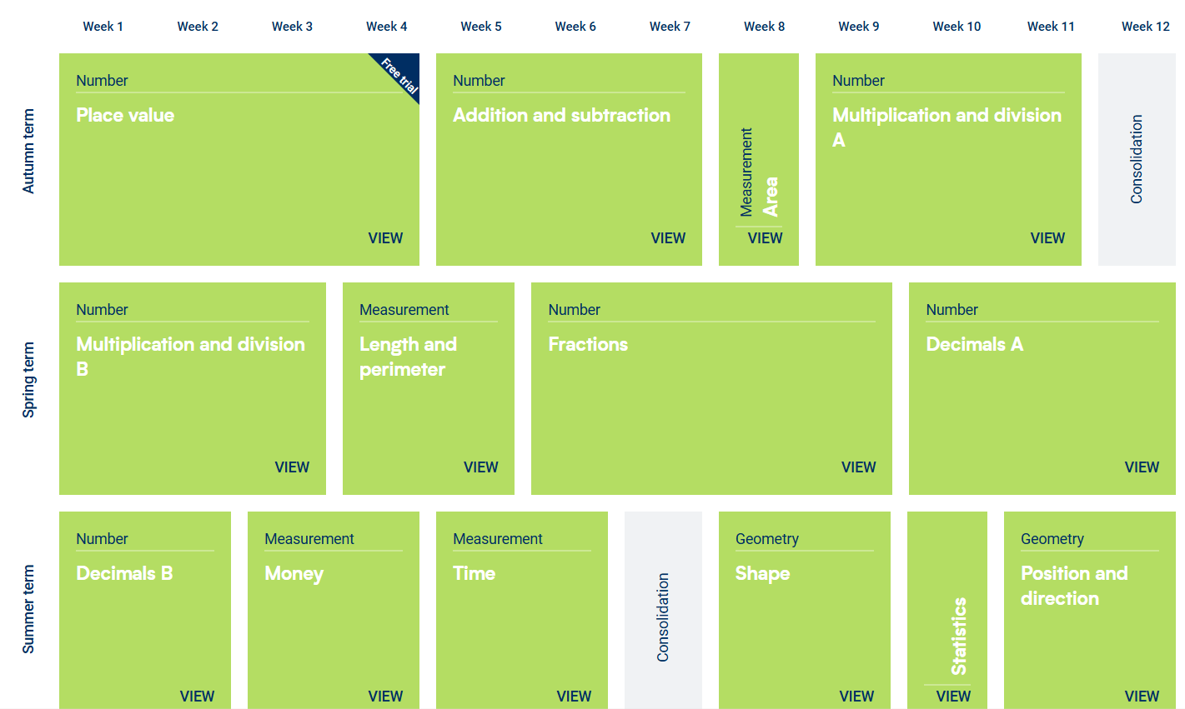
Maths:
These are the areas that the children will work on during Year 4.

Slide 8

Maths
For information on how we are teaching maths in school, please follow the link below.
School website –> Our Learning -> Maths support

Slide 9
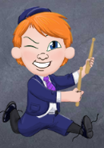
Multiplication
TT Rockstars:
Please use the Times Tables Rockstars app at home
to support your child with learning their tables.
We will be doing this daily in class.
Children in Year 4 will take the Multiplication check in June. You will have more information about this through the year and will be informed in their end of year reports about results. The curriculum suggests that by the end of Year 4, children should be fluent in the 2, 3, 4, 5, 8, 10, 6, 7, 9, 11, 12 times tables.

Slide 10


English: Term 1
Grammarsaurus- Place Value of Punctuation and Grammar
Focus text: Greta and the Giants by Zoe Tucker and Last by Nicola Davies
Text types and skills to be covered:
We will be writing fact files about our inspirational person for this term-Greta Thunberg.
We will be making notes and writing facts.
We will then be writing a non chronological report about extinct animals after reading about the last white rhino.

Slide 11
Writing expectations for Year 4
Write stories with a clear beginning, middle and end with coherent plot.
To proofread to proofread confidently and amend their own right and others writing.
To create more detailed settings characters and plot in narratives to engage the reader.
To consistently organise their writing into paragraphs around the theme.
To maintain an accurate tents throughout a piece of writing.
Punctuation
    capital letters, full stops, question marks, exclamation marks, commas for lists and apostrophes for contractions
    inverted commas for speech
Plan, draft and re-draft with a particular focus on spelling.

Slide 12
Spelling expectations for Year 4
The children in Years 2 – 6 will take part in daily spelling lessons, following the Active Spelling scheme of work (produced by the L.E.A.D. Teaching School Hub).
Spelling patterns/rules taught include:
suffixes –ed, -ing, -er, ture, sure.
adding the ‘ly’ suffix
ou, ous
ch
gue, qu, que, sc
Y for I
prefixes inter-, sub-, anti-, auto-, mis-, dis-
ation, sion, homophones
-tion, possessive apostrophes for plurals, ssion
selected words from the statutory spelling list for Years 3 and 4

Slide 13
Reading expectations for Year 4
using dictionaries to check the meaning of words
discussing words and phrases of interest
read and perform poems and plays and recognising some different forms of poetry
checking that the text makes sense to them, discussing the meaning of words in context
asking questions to improve their understanding
inferring characters' feelings, thoughts and motives from their actions and predicting what might happen next
identifying the language, structure, and presentation of text
A guided reading session will happen regularly using the Pearson Bug Club Scheme for Key Stage 2

Slide 14
Homework
Homework will be set online this year via Purple Mash. Homework will be uploaded to Purple Mash each Friday and should be completed by the following Wednesday.
Homework will be set for all children from
Homework will include:
Reading activity on Serial Mash
1 x maths activity on Purple mash
Regular Times Table Rockstars practise
Homework will be set for all children from Friday 20th September 2023.

Slide 15

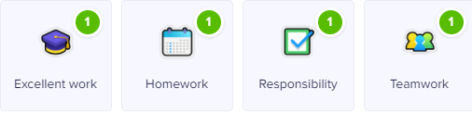

Class Dojo
Children can earn Dojo points for displaying any of the following:
Certificates will be presented if children reach the following milestones:
30 Dojos – Bronze
60 Dojos – Silver
100 Dojos – Gold
150 Dojos - Platinum

Slide 16

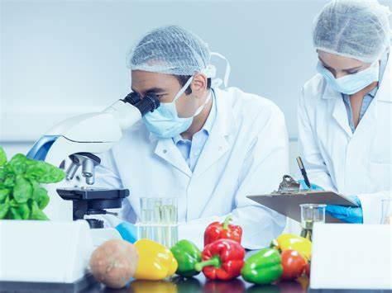
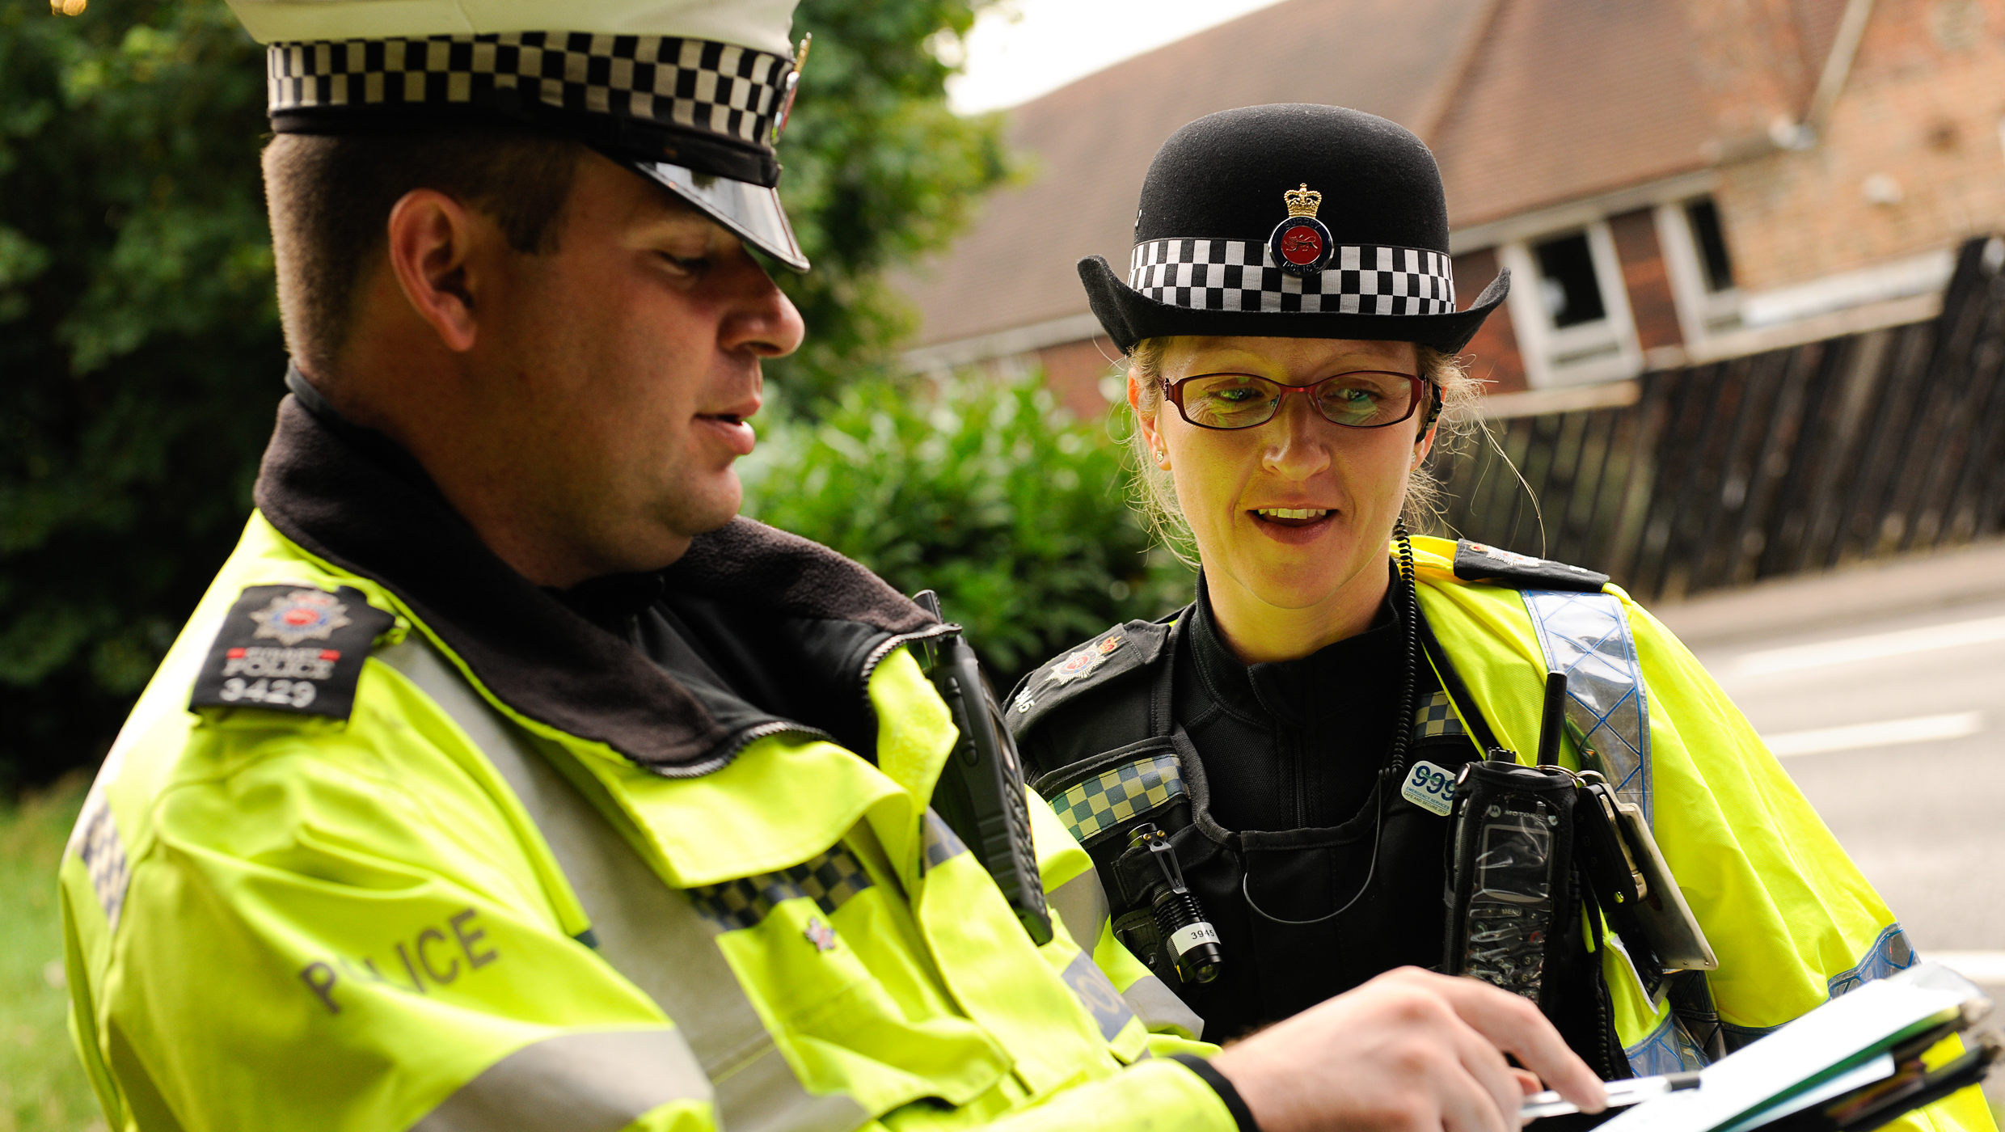
Aspirations
We are very keen to promote and enhance career aspirations for our children. To this end, we are exploring some of the careers that individual subjects could lead to.
Have a look at the booklets that have been produced by subject leaders to introduce the children to some of these careers…

Slide 17
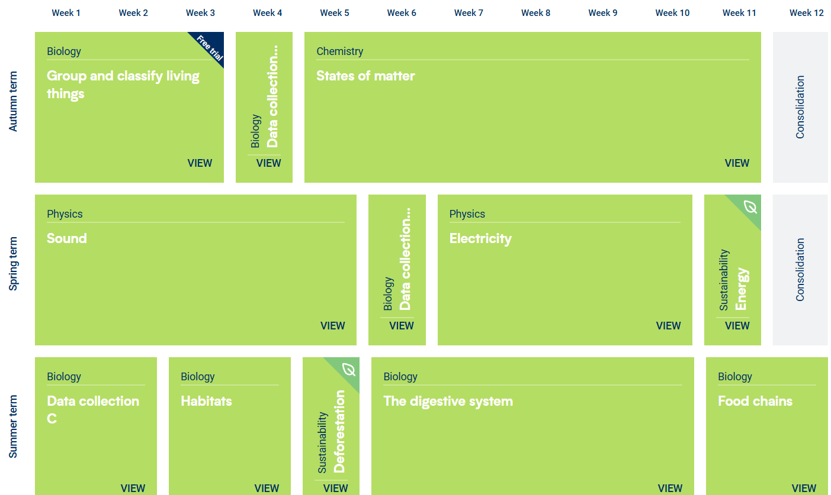
Science:

Slide 18
Key Assessment Dates:
Year 1 Phonics Screening
To take place during the week commencing 9.6.25
Year 4 Multiplication Tables Check
To take place during the period of 2.6.25
Year 6 SATs
Monday 12th May – Thursday 15th May 2024
Please note that from the 2023/24 academic year, the Key Stage One SATs (Year 2) are no longer statutory.

Slide 19
Collection arrangements
Please let either your child’s class teacher or the school office know of any changes to collection arrangements.
For safeguarding reasons, we cannot let children go home with adults not on collection lists unless you have given us prior notification.
Please note that dogs (except guide dogs) are not permitted on the premises under any circumstances.

Slide 20
What can you do to help your child?
Listening to your child read and questioning them about what they have read.
Times tables need to be learned – the expectation for the end of Year 3 is to know the 2, 3, 4, 8 and 10 times tables.
Times Table Rock Stars can be practised at home.
Provide a quiet place and encouragement for homework to be completed.
Use Maths in everyday situations, ask your child to tell you the time, what will it be in …?
Encourage your child to be involved with money when shopping, using the right amount of coins etc.

Slide 21
Remember the school website for additional information.
www.williamhildyard.lincs.sch.uk

Slide 22
We are looking forward to a very positive year ahead. Should you have any questions, please contact the school office via telephone or email and we will arrange a time to contact you.

